Slide 1
The Christmas Shop
R.Xefraj, E.Casapieri, A.Di Donato

Slide 2
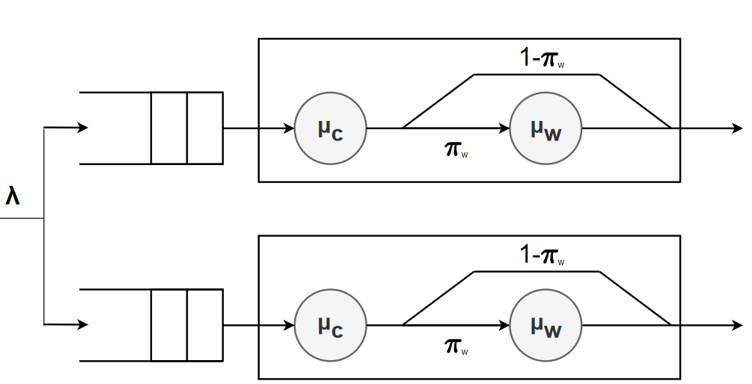
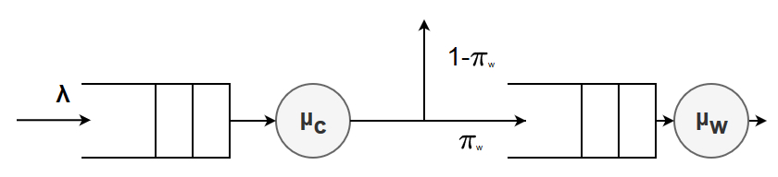

Problem
Large store with a number of checkout tills.Each cashier serves customers with a certain checkout rate, following the FIFO policy. To satisfy the desire to wrap purchases, there are also wrap tills, also with a certain wrap rate and with the same policy as the other type of checkouts. There are two possible approaches: converting a certain number of checkout tills into wraps or wrapping within the checkout tills themselves.
Policy 1
Policy 2

Slide 3
Assumptions
No upper boundary
FIFO
Equality
Respect for order
No limit is imposed on the number of customers in each tills
All tills adopt this policy
There are no differences in term of service between tills in the same scenario analysis
A customer cannot change is position in the queue
A till is forever
Resoluteness
No turning back
Randomness
A customer cannot change queue
Customers decide to wrap before checkout and regardless of the length of the queue
A queued customer cannot leave until he is served.
Customers choose tills in a pseudo-random manner

Slide 4




Factors
$$λ$$
Interarrival rate
$μ$_{w}
Wrapping rate
$π$_{w}
Wrapping probability
$μ$_{c}
Checkout rate
Mean inter arrival rate of customers at the shop per unit time
Mean wrapping rate of customers per unit time
Likelihood of customers deciding they want to wrap their purchase(s)
Mean checkout rate of customers per unit time
Notes:
The system, both in policy 1 and policy 2, is affected by the following factors:
Per la uniform k = 9/10
The mean value of each distribution is taken from the ini file. * Since the Uniform distribution needs the interval [a,b] the values * a=1/10mean b=19/10mean

Slide 5
Theoretical analysis
Stability Conditions
Policy 1 Each till M/Cox/1
Policy 2 Each Till is a M/M/1 Till
Wrapping till stability condition
Checkout till stability condition

Slide 6
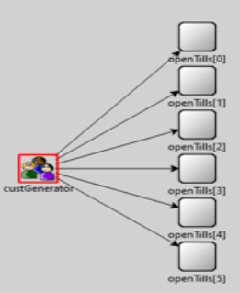
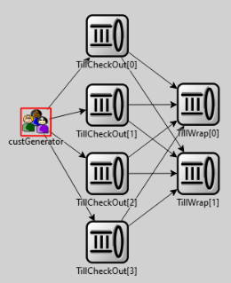
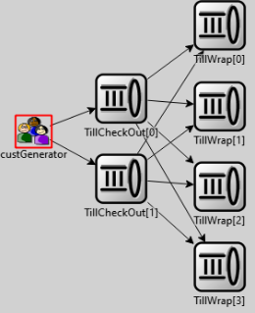
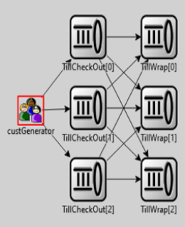
Implementation and Model Validation
Policy 1
Policy 2
NC = NW = 6
NC = 4, NW = 2
Tests carried out
Test 1: Constant interarrival rate, checkout rate and wrapping rate, wrapping probability equal to 1 and 0
Test 2: Constant interarrival rate, checkout rate and wrapping rate, changing wrapping probability
Test 3: Exponential/Uniform interarrival rate, checkout rate and wrapping rate changing wrapping probability and till full utilization
Test 4: Exponential/Uniform interarrival rate, checkout rate and wrapping rate changing wrapping probability not full utilization
Policy 2
Policy 2
NC = 2, NW = 4
NC = 3, NW = 3

Slide 7
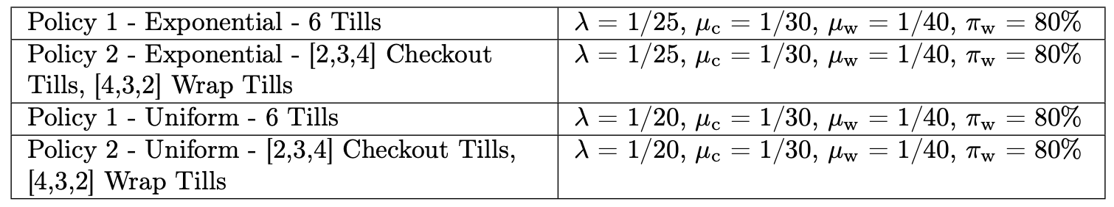
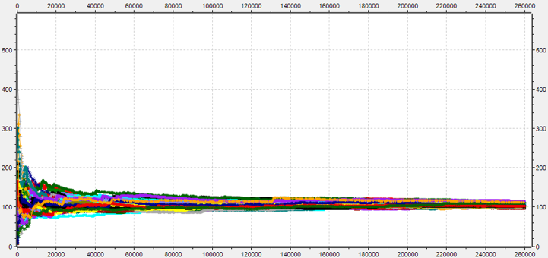
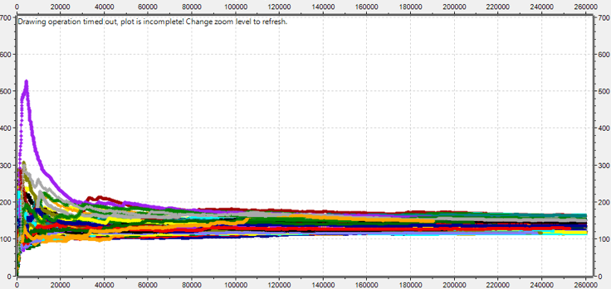
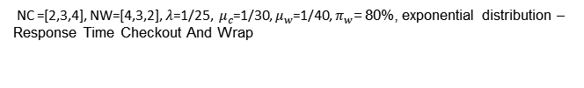

Warm-up and simulation time
The warm-up period that has been estimated to 60000s. This warm-up time has been obtained by considering the worst scenarios of the response time for the exponential and uniform distribution.
After the estimation of the warm-up time new simulations has been executed (excluding the warm-up time )in order to estimate the sample, mean and variance. Thanks to that values It has been estimated that simulation time must be 200000s in order to have a 10% accuracy with 95% confidence.
Worst case scenarios for each policy.
Number of tills=6, $λ$=1/25, $μ_{c}$=1/30, $μ_{w}$=1/40, $π_{w}$= 80%, exponential distribution – Response Time Checkout And Wrap
NC =[2,3,4], NW=[4,3,2], $λ$=1/25, $μ_{c}$=1/30, $μ_{w}$=1/40, $π_{w}$= 80%, exponential distribution –
Response Time Checkout And Wrap

Slide 8
2k r Factorial Analysis (r=10)
First policy factors:
A = initialInterArrivalRate
Exponential: [1/25, 1/30]
Uniform: [1/20, 1/25]
B = checkoutRate [1/25, 1/30]
C = wrappingRate [1/35, 1/40]
D = wrappingProbability [0.6, 0.8]
Relevant results:
The most influencing factor on the response time is the wrapping probability [exp: 42,72% uniform: 44,15%].
The second most influencing factor is the checkout rate with [exp:23.06% uniform: 21.50%].
Second policy factors:
A = checkout only tills [4, 3] (over 6 total tills)
B = initialInterArrivalRate
Exponetial: [1/25, 1/30]
Uniform: [1/20, 1/25]
C = checkoutRate [1/25, 1/30]
D = wrappingRate [1/35, 1/40]
E = wrappingProbability [0.6, 0.8]
Relevant results:
The dominating factor is the wrapping probability with [exp: 48,69% uniform: 40.27%].
The number of checkout only tills (A) has an influence of 8.18% in the exponential scenario and 9.42% in the Uniform and its interplay with the wrapping probability is 3.78% for the exponential and 9.42% for the uniform distribution.

Slide 9
Fairness Analysis - Lorenz curve
To calculate the fairness the Gini coefficient has been used.
Checkout fairness:
The policy 2 is fairer than the policy 1, since in the latter a customer which want only to checkout will also has to wait all the customers ahead of him that want also to gift-wrap their purchased goods.
N=6
NC=4
NW=2
NC=3
NW=3
NC=2
NW=4
Checkout And Wrap fairness:
Very similar results for both policies have been obtained.
N=6
NC=4
NW=2
NC=3
NW=3
NC=2
NW=4

Slide 10
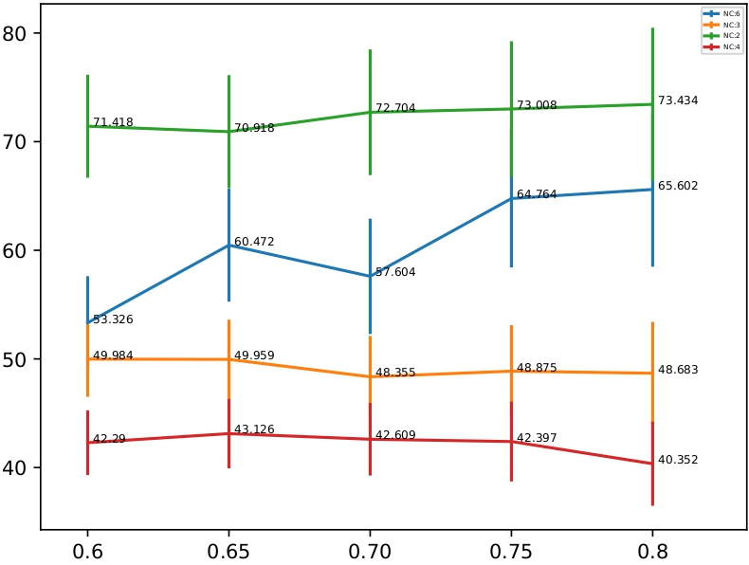
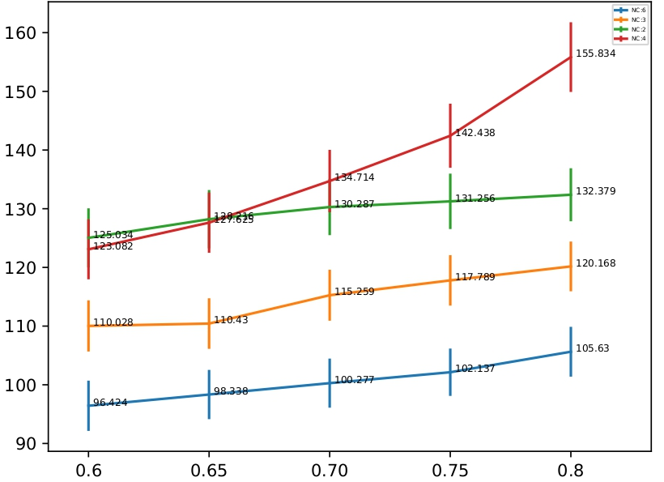

Changing Wrapping Probability – Exponential Distribution
Is there a winner policy by changing the wrapping probability?
Mean Response time for CHECKOUT-ONLY
Mean Cumulative Response time
Mean Response time for CHECKOUT-AND-WRAP
Wrapping probability
Number of tills=6, $λ$=1/25, $μ_{c}$=1/30, $μ_{w}$=1/40
Wrapping probability

Slide 11
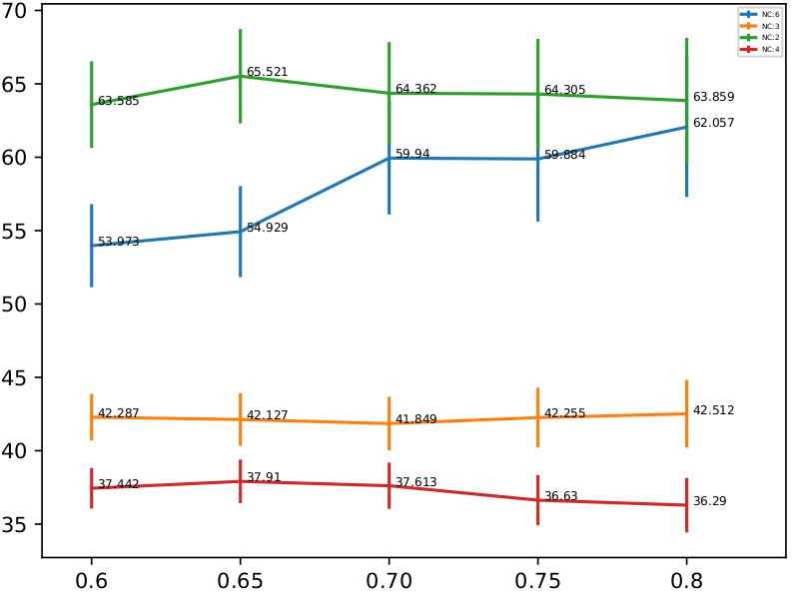
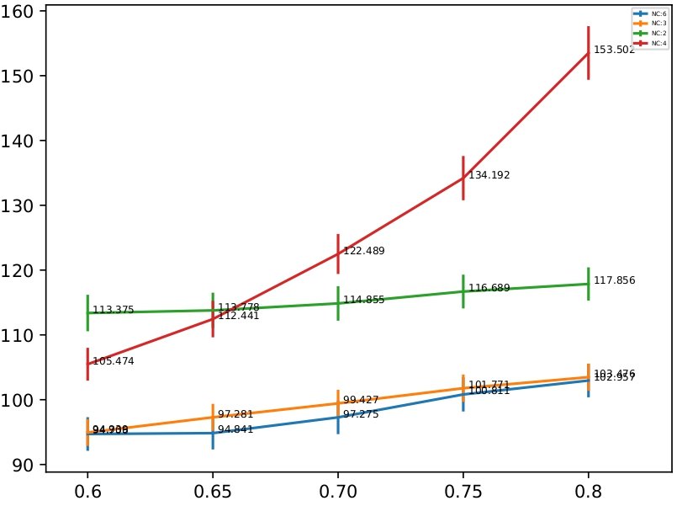

Changing Wrapping Probability – Uniform Distribution
Is there a winner policy by changing the wrapping probability?
Uniform
Mean Response time for CHECKOUT ONLY
Mean Cumulative Response time
Mean Response time for CHECKOUT-AND-WRAP
Wrapping probability
Number of tills=6, $λ$=1/20, $μ_{c}$=1/30, $μ_{w}$=1/40
Wrapping probability

Slide 12




Changing other factors
Exponential
Uniform
Checkout rate
Mean Cumulative Response time
Mean Cumulative Response time
Chekout rate
Checkout rate
Number of tills=6,${ λ\text{=1/2}5, π}_{w}$ = 0.8, $μ_{w}$=1/40
Number of tills=6,${ λ\text{=1/20}, π}_{w}$ = 0.8, $μ_{w}$=1/40
Wrapping rate
Mean Cumulative Response time
Mean Cumulative Response time
Wrapping rate
Wrapping rate
Number of tills=6, $λ$=1/25,${ π}_{w}$ = 0.8$,{ μ}_{c}$=1/30
Number of tills=6, $λ$=1/20,${ π}_{w}$ = 0.8$,{ μ}_{c}$=1/30

Slide 13
A bigger shop: 12 Till Analysis
Is a different solution more suitable for a bigger shop?
We used the same model as for the 6 tills shop. The theoretical analysis still hold.
The only factor that has been changed is the interval rate.
The estimated warm-up time is 60000s.
2k r factorial analysis: Scenario 2 Factors that has been changed for this analysis:
A = checkout only tills [4,6]
B = initialInterArrivalRate [1/12.5, 1/15]
The factors has the same influences of the 6 Tills scenarios.
Fairness: no significant difference has been noticed from the 6 Tills scenario.
Changing factors: No significant difference has been noticed from the 6 Tills scenario.

Slide 14
Conclusions
There are some differences between the two distributions analyzed:
For the exponential scenario, for most of the factor analyzed the best configuration is the one where every till perform both the checkout and wrapping service (Policy 1).
For the uniform scenario is more difficult to assert a winner between Policy 1 and Policy 2 (NC = NW = N/2) with CI=95% since most of the time the mean results overlap each other.
GENERAL CONCLUSIONS:
balanced configurations, with the same number of checkout tills and wrapping tills, are the ones in which the mean response time is the lowest

